Slide 1
Employability: Professional Career Start Strategies & Job Search
Olivia Doyle
AUSTRALIAN RESUMES &
COVER LETTERS
25 November 2015
Notes:
Save this template as a new PowerPoint Presentation, giving it the name you require OR copy these templates from Slide Master view into your existing presentation’s Slide Master options
If you go to >View > Slide Master you will see this template can be applied in Black, White or Grey background versions (which you will apply as you build or edit your presentation)
Close Slide Master view. You can now construct your presentation.
In the Slides area, select ‘New Slide’ to add a new slide.
To apply a slide style to the new/highlighted slide - in the Slides area, select ‘Layout’ menu, select preferred slide style from the menu (eg. ‘Title and Content’) , select ‘Reset’.
If you are updating an existing presentation, existing styles may not automatically update (hence using ‘reset’,) especially if the existing slide has not been produced with a template.
Text from imposed text boxes may need to be cut & pasted into new auto-generated template text boxes etc.
You should only use one colour template for each presentation (eg. Only black background, or white, or grey – not a combination)
The Design uses only 24pt Arial as the font, with 22pt the minimum text size (used at third level).
The title page ‘wave’ graphics can be increased in width, but not height.
1

Slide 2

Tell your story to stand out from the crowd
Most jobs require written applications to assist recruiters to identify the candidates to short list for interview
You need to ensure ALL aspects of your written application tell your story in the most effective manner to market you as a qualified, talented individual who matches the employer’s selection criteria
Notes:
Consider ways to differentiate yourself i.e. give examples of positive outcomes “Achievements” in your communications; include these where you can in your resume.
Discuss why “Achievements” are very important in effectively differentiating yourself.

Slide 3

What is a resume?
A marketing/sales tool - a brochure that tells your story and QUICKLY promotes your skills and achievements
A document that presents you as a professional
Maps why you are a match to the job on offer AND to the organisation
The key to gaining an interview
Notes:
Your resume is often the first impression the reader (i.e. prospective future employer, or recruitment consultant) may get of you. Never underestimate the power of making a great first impression. You want your resume to entice the reader to want to find out more about you and subsequently invite you to interview.
Your resume is only one (of many) marketing tools you will develop to effectively market yourself in the workplace.
Question: Apart from your resume, what other things (i.e. marketing tools) may assist you in marketing your knowledge, qualifications, skills and abilities etc? (Hopefully students will enjoy brainstorming and discussing ideas such as cover letter, selection criteria documents, linkedin profile etc.
Emphasise the importance of having a consistent message throughout all marketing tools. For example, your cover letter should address key selection criteria required for an advertised role, your resume should highlight ‘achievements’ that demonstrate how you meet advertised selection criteria; and additionally – your STAR examples prepared and performed at interview … should reflect achievements in your resume and selection criteria addressed in your cover letter etc.
Good preparation and consistent message with all marketing tools – enables us to best professionally market ourselves and effectively differentiate ourselves in “individualising, and telling our story”!

Slide 4
Common mistakes in written graduate applications
Bland applications - candidate does not stand out from the crowd
No obvious links to the job – the reader has to join the dots
Not addressing selection criteria
Poor written communication skills
  - Spelling
  - Grammar
  - Expression
  - Presentation
  Expression
Notes:
Feedback from employers suggests a lot of graduate applications are of a poor quality.
Many are very similar with few points of difference to make them ‘pop’ or ‘standout from the pack’

Slide 5


How long does it take for a recruiter to assess a resume?
Often less than 20 seconds
So what makes a good resume?
Notes:
5
Quick brainstorm of the key elements of a professional resume in pairs - 2 mins
Eg
Marketing focus
Highlights relevant information
Uses key words
Joins the dots for the recruiter linking your qualifications and experience with the key selection criteria
Highlights good communication skills
Leaves the reader with a good impression of the candidate and demonstrates job and organisational fit
http://www.businessinsider.com.au/heres-what-recruiters-look-at-during-the-6-seconds-they-spend-on-your-resume-2012-4
This article shows an interesting visual of where recruiters eye movements are concentrated on resumes. The study showed recruiters will look at your name, current title and company, current position start and end dates, previous title and company, previous position start and end dates, and education.

Slide 6

What makes for a winning resume?
Content
Matches the requirements of the employer
Uses short, clearly written phrases and paragraphs to demonstrate your skills & experience
Layout
Clear and easy to scan
Uncluttered
Appropriate format
Adequate margins and whitespace white space
Notes:
http://www.businessinsider.com.au/resume-heat-map-jobs-strategy-2015-4

Slide 7
Resume layout / presentation
Make the résumé as simple and easy to read as possible
Consider type styles and font size (eg Times New Roman, 12)
Avoid font mania - use only one plain font – Arial or Times New Roman set at 11 or 12 point in size
All indents are in alignment (use Tab & indent settings NOT spacebar)
Use bold / italics / boxes (borders) wisely
Avoid italics or underline as they don’t fax or scan into a database well
Don’t OVERCAPITALISE
Use page breaks so lists and paragraphs are not split

Slide 8

Vital resume content
Targeted to the requirements listed in the advertisement
Use of key words
Highlights the strengths of your brand
Tell a positive story
Achievement focused
Concise
Honest
Notes:
Important to note: use of key words, phrases, key selection criteria wording – is critical. Especially when you consider visual scanning, in person or via technology – to determine who meets specified selection criteria, and subsequently – who may be shortlisted for interview.
Remember, the importance of first impressions – this is especially critical when communicating your personal brand (i.e. differentiating yourself, telling your individualised story to entice the reader to want to interview you and find out more about you).
“Achievements” are critical – quantifiable language here is key (i.e. percentages, $ figures and words better than ‘good’ … this enables readers to quickly assess how effective you have been in role.
Don’t forget to spell check – it’s a good idea to have someone do a final edit on your resume too!

Slide 9
It’s a crowded market!
The average time a recruiter spends looking at a resume is 5.7 seconds
On average 250 resumes are received for each job position
76% of resumes are ignored if your email address is unprofessional
The first applications are received 200 seconds after a job is posted

Slide 10



Recruiters often short list job applications into three categories
Which pile will your story end up in?
YES MAYBE NO
Notes:
One employer at our recent Career Conference gave the following statistics:
- Cuts out 30% of applications based on spelling and grammar in the cover email before even looking at the resume
- Looks briefly at qualifications and experience and then cuts out 40-50%
- Only reads about 5% of applications in full

Slide 11
Resume Styles
Reverse Chronological
Arranges your experience and education in reverse chronological order (from most recent to least recent)
Functional
Headings relate to your relevant skills and competencies rather than time-line order
Creative
Using the resume as a tool to demonstrate your design/creative skills using colour and images etc

Slide 12
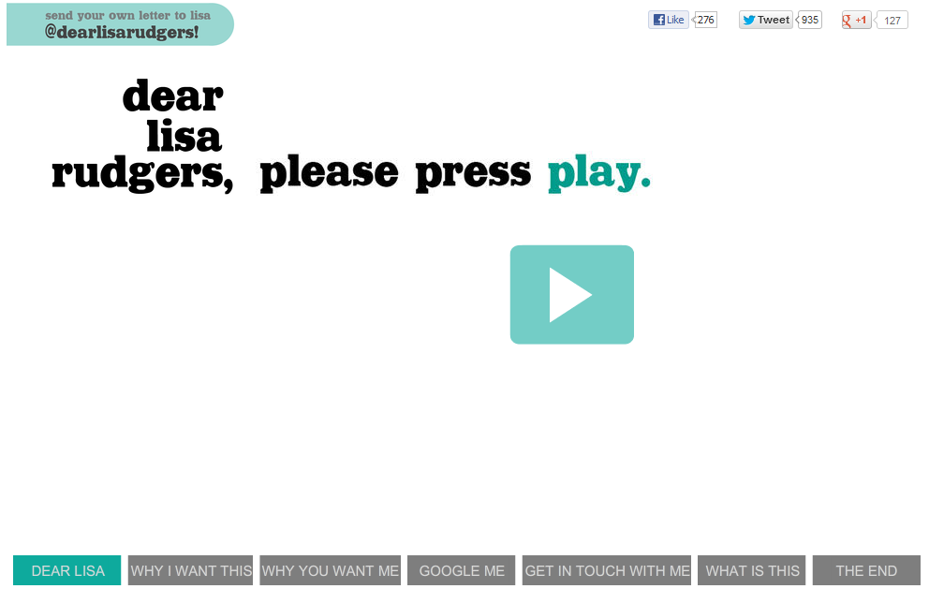
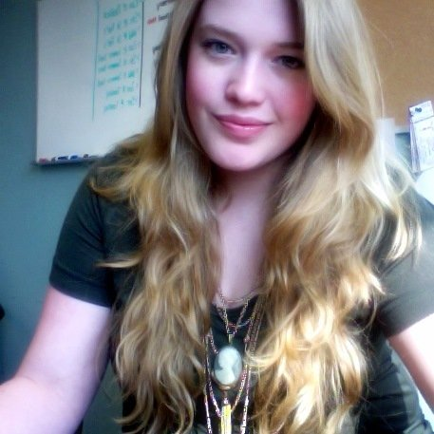


Being creative – what do you think?
What roles would this type of resume be best suited?
Notes:
This graduate Lyndsay Blackwell really wanted to work for Michigan State University
Although Lyndsay didn’t get the role but her application went viral and she landed a similar role.
Video runs 3.08 minutes – probably no need to show entire clip
Get student feedback
Eg – what roles would this resume be best suited? What are pros and cons

Slide 13
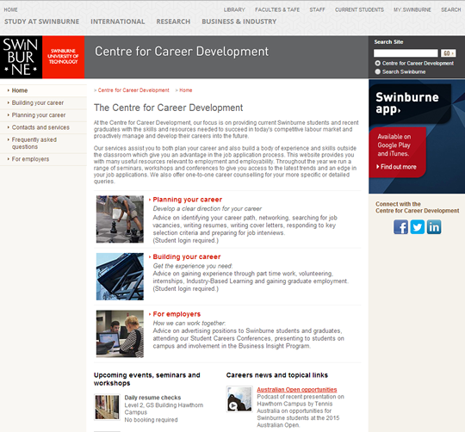
Resume builder & example resumes
Access SwinEmploy at www.swin.edu.au/careers
Notes:
Very important that you highlight the following:-
The Centre for Career Development website provides valuable resources to assist you with “applying” for jobs
Once in the Centre for Career Development website click on ‘Planning Your Career’ (tab in top left-hand margin)
Next, you will be prompted to log-in, then after clicking on ‘Planning Your Career’ you will have options of Plan, Search, Apply, Interview, Review.
Next, to access information on applying for a job (i.e. to access resources on ‘Developing your Resume”, “Cover Letters” and “On-line Applications and Selection Criteria” ) click on “Apply”
Once in “Apply” you will see all the available resources available to assist you in applying for a job.
Important: if students refer to “Sam Chronological” resume example (in “Developing Your Resume” handout) – it makes it easier for them to develop their own resumes for CIC submission. This resume example gives content and format tips and ideas.

Slide 14
Resume content – sample headings
Contact Details
Education / Qualifications
Professional Development
Demonstrated Skills Summary
Employment History
Project Work/Industry Projects
Volunteer Work
Referees
Hobbies
Extra Curricular Activities
Associations / Memberships
Career Objective/Career Profile
NOTE: Not all of these headings are required for all resumes.
Notes:
Standard resumes have a mixture of the following headings. Encourage the students to think of what is relevant for them and build their resume appropriately.

Slide 15
Resume content – irrelevant information
Date of birth / age
Place of birth
Nationality
Ethnic origin
Marital status
Number of children
Religion
Political persuasion
Health
Height / weight
Photograph
WHY?
Notes:
Standard resume styles differ from country to country and it is vital to make students aware that if they travel overseas or are new to Australia they need to adjust their resume accordingly.
The standard page limit in Australia is a maximum 4 pages although some countries prefer 1 or 2 pages only – refer to Going Global for international resume styles
Discuss briefly WHY Australian resumes have removed this info.

Slide 16

Contact details
Name (first name and surname)
Address (optional)
Telephone Number
Email Address
Link to your LinkedIn profile
Link to on-line portfolio (esp. for Design students)
* Work visa status for international students
Notes:
State you will provide a brief overview of resume basics – for more information check out examples and information in “Developing Your Resume” handout (PUT ON BLACKBOARD) and in C&E podcast
References at end of presentation

Slide 17
Professional profile example
      Marketing graduate with expertise in research, social media and campaign development
      Experienced in telecommunications sales and regularly exceeded sales targets
      Winner of Business Sales 2014 Telstra Award
      Strong communication skills, self-motivated and driven to learn and succeed
      Targeting a graduate marketing position with a focus on xxxxxxxx
Notes:
Read this slide and then refer to next two slides for Career Objective and Professional Profile examples.

Slide 18
Career objective example
      Highly motivated, professionally focused Bachelor of Business (Human Resource Management) student due to graduate in 2015.
      Excellent skills and experience in business analytics and strategic planning, now seeking a challenging graduate human resources role.
Notes:
Read this slide (discuss)

Slide 19
Education
Present in reverse chronological (date) order
No need to include international secondary education
EDUCATION
2013 - Current Bachelor of Commerce (Human Resources)
Swinburne University of Technology
Key Study Areas:
- Recruitment and selection
      -- Training and development
      - Remuneration
      - Strategic workforce planning
      Distinction average achieved to date
Notes:
Many students in their EDUCATION section of their resume – list unit/subject names under Key Study Areas: (please note that unit names are detailed in your academic transcripts so therefore not required in resume).
Key Study Areas: sub-section is an opportunity for students to market their areas of discipline interest; i.e. as per this slide detail.

Slide 20
Related headings
Professional Development (seminars, short courses, certificates RELATED to the position you are seeking)
Industry specific headings
Eg Aviation Licences / Ratings / Endorsements / Certifications / Software Licences
Short Courses
Academic Awards
Industry Projects / Capstone Projects

Slide 21
Professional memberships
2013 – Current Student Member
Australian Computer Society
2013 – Current Student Member
Australian Institute of Management

Slide 22
Employment history
A chance to demonstrate how your brand differs from others
Present in reverse chronological order
Include dates and duration
Do not include any position beyond 10 years (unless highly relevant)
Document ‘Responsibilities’ and ‘Achievements’ for each role held
Consider separating relevant employment / experience from other experience (this is especially useful when your most relevant experience is not necessarily your most recent)
Consider using sub-headings, i.e. Professional Employment, Other Employment or Volunteer Work
Notes:
Emphasise the importance of listing ‘Achievements’ for each role held. This is a great opportunity to market yourself, i.e. your style, positive results etc.
Think of transferable skills i.e. casual retail jobs (customer service performance levels) and how this can be transferred and applied to a future professional role.
Also, highlight the importance of using sub-headings in this main “EMPLOYMENT HISTORY” section (discuss)

Slide 23
Example of employment section
PROFESSIONAL EMPLOYMENT
2012-2013 HR Officer (Industry Based Learning)
Blue Chip IT, Hawthorn
Responsibilities
▪ Preparation of selection criteria and position descriptions
▪ Coordinated recruitment of administration and technical staff
▪ Induction and training of new staff
Achievements
▪ Streamlined induction procedures by developing web based materials

Slide 24
Use of Achievements
Wherever possible describe achievements quantifiably
Promotions
Increasing sales figures or improving efficiencies
Being part of a team that….(what your team did) – implementing or designing systems or processes
Winning an award or prize – even a trivial one
Employee of the month / year
Customer service / quality awards
Notes:
Highlight the importance of detailing “positive outcomes / in quantifiable language – i.e. using $ figures, percentages or words better than good – when describing a good achievement. Achievements can be detailed for all roles (including volunteer and casual work).

Slide 25
Other Employment (or Casual Employment)
June 2012 – Present Crew Member
McDonalds, St Kilda
Responsibilities:
- Dealing with customers
- Preparing food and cleaning
- Working in team of approximately10 people
- Handling cash and balancing tills
- Following OH&S practices
- Training new staff members
Achievements:
- Awarded ‘Crew Member of the Month’ on two occasions
- Regularly exceeded sales targets via effective cross selling

Slide 26
Industry engaged learning
This section can be used to demonstrate relevant industry projects or case studies you have been involved in. These could include examples of:
Relevant capstone university projects
Team projects
A final year project
Relevant volunteer work
Professional organisations and participation

Slide 27
Skills summary
Opportunity to match yourself to the job and to convince employer of your potential
Highlight 4 - 5 professional skills that you can offer an employer which are relevant to the position you are applying and match the selection criteria
Give two examples of how you have demonstrated the skills
Focus on providing strong examples that highlight your capacity and that differentiate you from other applicants
Notes:
Demonstrated SKILLS SUMMARY. Highlight the important of indicating professional skill level and how you developed each skill etc.
Keep the a professional focus on skills, ie. Organisational, communication, Analytical etc. Do not list personal traits, i.e. hard-working etc.

Slide 28
Skills summary - example
Communication Skills
Highly developed interpersonal skills strengthened through four years of customer service experience as a Supervisor at Coles Supermarket
Strong written communication skills demonstrated in university assignments and in preparation of position descriptions and training manuals at Blue Chip IT

Slide 29
Skills Summary – cont’d
Proof / Demonstrated Evidence
Communication skills
Written
Planned and wrote reports and researched essays.
Publicised student events as part of sporting clubs. Developed promotional flyers.
Wrote the project briefs for a market research survey on fast foods in convenience stores for Heinz Watties Ltd.
Completed the business plan for a proposed new business venture for the Brotherhood of St Laurence.
Oral
Presented papers at tutorials.
Instructed laboratory classes on how to conduct experiments.
Gave an introductory welcome and presentation to 1st year international students.
Developed the ability to communicate effectively under pressure as a sales assistant at a 7-11 convenience store.

Slide 30
Skills Summary – cont’d
Leadership (Initiative and Enterprise)
Proactively taken leadership roles during group projects, leading and guiding teams into meeting deadlines and providing effective solutions to problems.
Actively managed, organised and co-ordinated team workload and tasks, set due-dates and deadlines for components of system design and implementation for university projects and assignments.
Ensuring involvement and support of team members as a critical part of working as a team to ensure productivity while allowing the expression of individual talents.
Undertaken leadership camps and teamwork courses provided by the co-op scholarship program with companies such as Operation Challenge and Oxygen Learning.
Planning and Organising (Organisational)
Prioritised daily, weekly, monthly tasks to meet university deadlines.
Effective at managing time and balancing full-time study with part-time work, as evidenced by handing in all my assignments on time.

Slide 31
Interests
Employers are always interested in you ‘the person’ and your potential fit to the organisation
They are curious to know about your hidden talents or interests – especially if they relate to the profession you are seeking to enter and the organisation
Make sure you highlight a wide range of interests
Clubbing, swords, surfing the net, Facebook, meeting new people and hunting are NOT appropriate on resumes

Slide 32
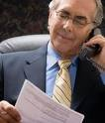
Referees
No matter how good your application and interview were – if your references are not positive – you won’t get the job.
No one is obliged to give a positive reference – make sure you choose someone with whom you had/have a good rapport
Should be work and study related
Show your referees the courtesy of asking for their permission and notifying them when you apply for jobs.

Slide 33

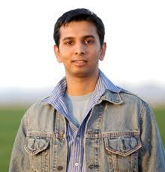

Resume case study ACTIVITY
Jay Kapoor is a final year of student at Swinburne and is looking to develop his resume to apply for graduate Accounting positions.
Jay is confused about what information to include in his resume.
Based on your knowledge of a resume as a personal marketing document, identify which information you think should be:
Included
Omitted from the resume
… and note reason for your decision (next slide)
Notes:
Activity
Introduce the activity that will run for approximately 30 minutes. Advise students that this activity can be done in pairs or individually to decide on what information is appropriate to include or omit in Jay’s resume.
The following slide will number and list information to be considered for Jay’s resume – students will write the number of each item and place a tick or cross next to each item that should or not be included in Jay’s resume (briefly noting reasons for decision) – in their note pads.
Perhaps have some spare paper for students that don’t have note pads or otherwise.

Slide 34
Bio of Jay Yashwant Darshan Kapoor
1. Full name
2. Home address, telephone, email
3. Linkedin profile address
4. Single
5. Age 23
6. Good health
7. Completing a Bachelor of Commerce majoring in Accounting with minors in Finance and Commercial Law
8. Overall pass average results achieved to date with credits and distinctions in accounting subjects
9. Started a Bachelor of Sports Management at Deakin University – completed first year
10. Primary School – Rowville Primary School
11. Year 7 – 9 Dandenong High School. Won a ‘distinction’ award in Year 9 Westpac Mathematics Competition
                List continued on next slide …
Notes:
Activity
Continue activity - allow 1 minute (at most) for each number item and for students to note why would include or otherwise in Jay’s resume.

Slide 35
12. Year 9 – 12 Rowville Senior Secondary College
13. After dropping out of Deakin studies travelled overseas for 18 months visiting South America, Europe and India
14. Part-time and casual jobs include: Cleaner for 6 months, Customer Service Assistant at Coles for the past 9 months (still working), paper delivery for 3 months at age 14, Waiter for 2 weeks, Bookkeeping and Customer Service with his parent’s newsagency business, Industry Based Learning accounts position for 6 months
15. Advanced excel, basic Word and PowerPoint, intermediate MYOB
16. Hobbies: Poker, hunting, basketball – member of Rowville Rockets for past 5 years and captain for 2 years.
17. Volunteer with Liberal Party of Australia (current) and RSPCA (in Year 10 at school)
18. Referees: Family friend, father, Tutor and Work – contact details
Notes:
Activity
Continue activity - allow approx. 1 minute (at most) for each number item and for students to note why they would include or otherwise in Jay’s resume.
Briefly discuss highlighting salient points, in particular:
DO NOT INCLUDE:
Full names – eg can leave out middle names and if you wish, can use your ‘known as name’ that friends and family call you
Age
Health
Primary school or early secondary education – VCE is sufficient
Paper delivery at age 14 or school work experience
Academic achievements from junior or intermediate primary schooling
Two weeks work as a waiter
Volunteer experience which may be controversial (eg Liberal Party) or very distant
Hobbies such as gambling or hunting
Referees whom are family or friends
DISCUSS
How to manage average / poor academic results / stronger results in certain subjects
Course changes
Travel
STRESS
Importance of IBL experience and relevant experience in family business
Team memberships and positions of leadership
Industry related university projects

Slide 36
Cover Letters
Your resume focuses on you and the past. The cover letter focuses on the employer and the future.
Tell the hiring professional what you can do to benefit the organisation in the future.
Notes:
The ‘Cover Letter’ – is a formal letter often required to be sent with your resume (as a separate file), and sometimes also in conjunction with a selection criteria (separate) document.
Additionally, please note that similar ‘Cover Letter’ content can be sent via email (if required).

Slide 37
What is a cover letter?
A formal letter of introduction
States your interest in the position or organisation – why do you want to work for them and your skill match
Provide an overview of your qualifications
Outline your employment history or relevant experience
Match your skills to those required for the job – Technical and Generic
Good indication of your communication skills
Notes:
Highlight your relevant strengths and demonstrate how you meet the criteria. No more than one page. Direct to template online and “Cover Letter” handout via Career’s website

Slide 38
Purpose of a cover letter
Can you do the job?
Show you have the abilities, skills, knowledge and experience to perform the role.
Will you do the job?
Show you are interested in the work itself and that you have the personal qualities necessary to succeed in the role and the organisation.
Will you fit in?
Show how your values and goals match those of the organisation. The examples that you choose to share can also demonstrate how you might fit in with clients and co-workers.

Slide 39
Amanda Kaur
22 Henderson Rd
Epping Vic 3071
Ph: 9878 4456 Mob: 0432 907 123
Email: a_kaur@bigpond.com
18^{h}February 2015
Mr Robert Brown
General Manager
C & E
Thomastown Vic 3074
Dear Mr Brown,
Re: Book Keeper and Office Assistant
Please accept my application for the position of Book Keeper and Office Assistant with C & E as advertised on the Seek website on the 18th January 2015. I believe my skills and relevant experience would enable me to make a significant contribution to C&E.
I am undertaking a Bachelor of Business majoring in Accounting at Swinburne University of Technology (TAFE) and am looking forward to utilising the skills I am gaining in my course to join a company devoted to environmentally friendly car care products. This course is providing me with the knowledge and skills to efficiently work in an accounting and office administration role and the assignments have strengthened my ability to process accounts payable and receivable; update customer accounts records; produce a variety of financial records; and enhanced my office administration and keyboard skills. I am a confident internet user and familiar with MYOB and the full MS Office suite. This can be supported by my referees who will also be able to confirm my enthusiasm and ability to problem solve client and financial discrepancies.
Utilising my good organisational skills I have balanced full-time study with part-time employment with Mumbai Property Exchange. My duties include reception and general office administration. As Mumbai Property Exchange is a market leader in the area, I was expected to demonstrate high level communication skills, professional standards and client confidentiality. At times, I am in charge of the office so I am very capable of dealing with high volume customer service and a wide range of client enquiries.
Enclosed is my resume for your consideration. I look forward to discussing the position and my application further and can be contacted on 0432 907 123.
Yours sincerely,
Amanda Kaur
Your name and address
Date
Employer or agency name, title, address
Salutation (eg Dear Mr Brown or Dear Sir / Madam)
Reference line
Yours sincerely / Yours faithfully
Sign and type your name
Notes:
39
Provide summary of key parts of letter, highlighting a structure suitable for most graduate applications:
Paragraph 1 – title of the position, where advertised, briefly highlight why you are applying and what you can contribute, demonstrate understanding of organisation
Paragraph 2 – overview of qualifications and relevance to position advertised
Paragraphs 3 & 4 – overview of employment history, transferable skills you have developed and their relevance to the position advertised. Also include other achievements, experiences, projects etc that may be relevant
Paragraph 5 – summarise why you are a strong candidate for the role. Refer to enclosed resume. Suggest a course of action.
IMPORTANT: please highlight again for students that “Cover Letter” resources can be sourced via the Centre for Career Development’s website, click on Planning Your Career and then “Apply”

Slide 40
Cover letters - useful tips
Be relevant. Review the advertisement and reply specifically to what you see are the main requirements. How do you believe you can contribute to achieving what they are looking for from the role.
Be personal. Write your cover letter in the first person.
Be concise. Keep your cover letter to 1 page only.
Be direct. Address the letter to the relevant contact listed in the advertisement, by name where possible.
Be specific. Refer to the advertised job title, reference number and where you saw the job advertised. Customise your letter to each job you apply for.
Be purposeful. Outline the reason for your interest in the role/company.

Slide 41
Cover letters - useful tips
Be positive Demonstrate an upbeat and enthusiastic attitude to work
Be correct Use spell check and proof read your letter before submission
Be complete Re-read the advertisement and make sure you have covered all of the requirements
Be professional Even if you reply to the advertisement electronically or via email, include a cover letter

Slide 42
Common cover letter mistakes
Generic Cover Letter | The one-size-fits-all approach is ineffective because it doesn’t allow you to address the company's goals, objectives and specifications.
Providing unnecessary information | Never include information that isn’t relevant to the company. Keep your cover letter to four or five paragraphs Don’t exceed one page
Focusing on yourself | The employer won’t contact you if you share details that aren’t related to the indicated job requirements. The question shouldn’t stop at “What can you do?” It should rather be “What can you do for the company?”
Emphasising Weaknesses | Carefully read your letter several times and find both spelling and grammatical errors.

Slide 43
A well written cove letter will:
Convey your interest and motivation to work in the company and/or role
Connect your qualifications to the company's goals
Indicate your value proposition to the organisation
Encourage the reader to learn more about you in your résumé

Slide 44

Cover emails
Most applications are submitted via email also require a short cover email
Tips
Mention the job title and reference number
Express interest in the position highlighting that you possess relevant qualifications and experience
Refer to attached cover letter and resume
Ensure your written expression, spelling and grammar are perfect – or the attachment will not get opened!

Slide 45
Additional support
Free resume & cover letter checking service provided by Centre for Career Development
Comprehensive handout and examples of resumes and cover letters
www.swin.edu.au/careers

