Slide 1

Universal Properties of a strongly interacting Fermi gas
P. Drummond, H. Hu, X-J. Liu,
E. Kuhnle, P. Dyke, M. Mark,
S. Hoinka, Chris Vale, P. Hannaford
Swinburne University
of Technology,
Melbourne, Australia
Notes:
- I’d like to thank the program committee and conference organisers for the opportunity to speak to you today.
I want to tell you about some of the experimental work we’ve been doing at Swinburne in Melbourne, using Bragg spectroscopy to study universal properties of Fermi gases
This work is part of the ARC Coe for QAO

Slide 2
What is the coldest measured temperature?
Why does this matter to us?
How is it changing modern physics?
What kind of theory is needed?

Slide 3

Vostock Station, Antarctica (180K)?

Slide 4
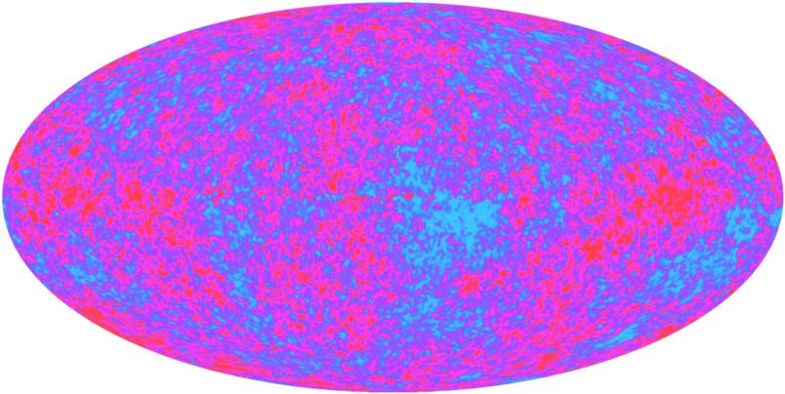
Outer Space (2.7K CMB)?

Slide 5
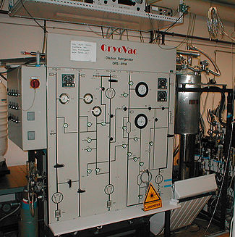
Helium Dilution Refrigerator (1mK)?

Slide 6
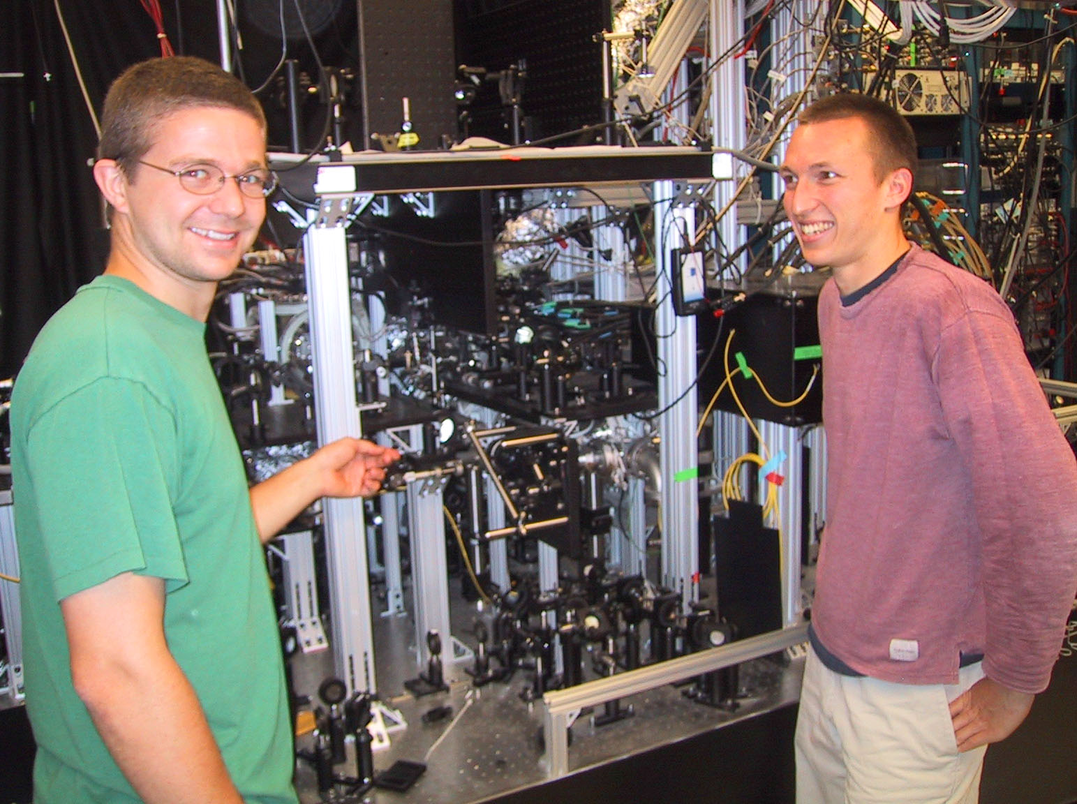
Ultra-cold Atomic BEC (1nK)?

Slide 7
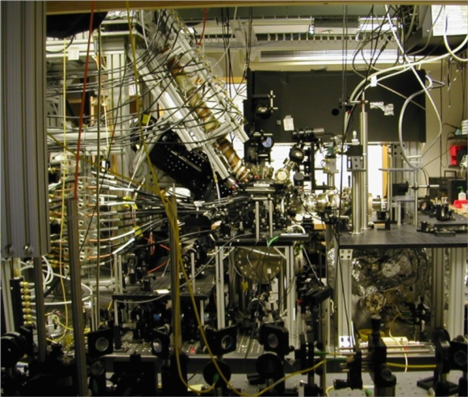
Atomic spin-lattice (50pK)!

Slide 8
Universality in the BEC-BCS Crossover
Pairing and superfluidity depend on the interactions & temperature
Bosonic
Unitary
BCS
T*
T_{c}
We use Bragg spectroscopy to probe the region where universal behaviour occurs
(Ketterle & Zwierlein, Enrico Fermi School, Varenna, 2009)
Notes:
Ultracold Fermi gases in the BEC-BCS crossover are an excellent system to study aspects of universal behaviours
This picture shows the phase diagram of the bec-bcs crossover
we can see that both pairing and superfluidity have a non-trivial dependence on the temperature and nature of the interactions
The green region, highlighted here, is the region in which universal behaviours occur and is particularly difficult to treat theoretically, due to the lack of a small interaction parameter which means the usual perturbative theoretical approaches cannot be used

Slide 9
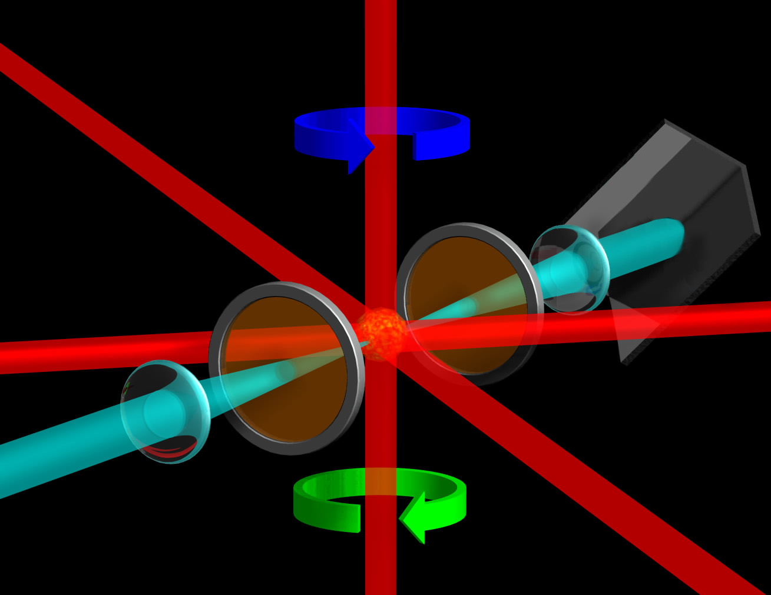
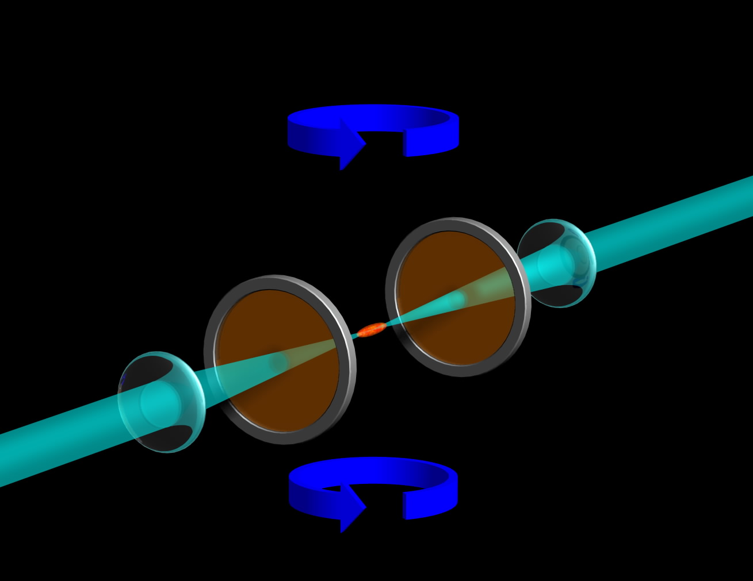
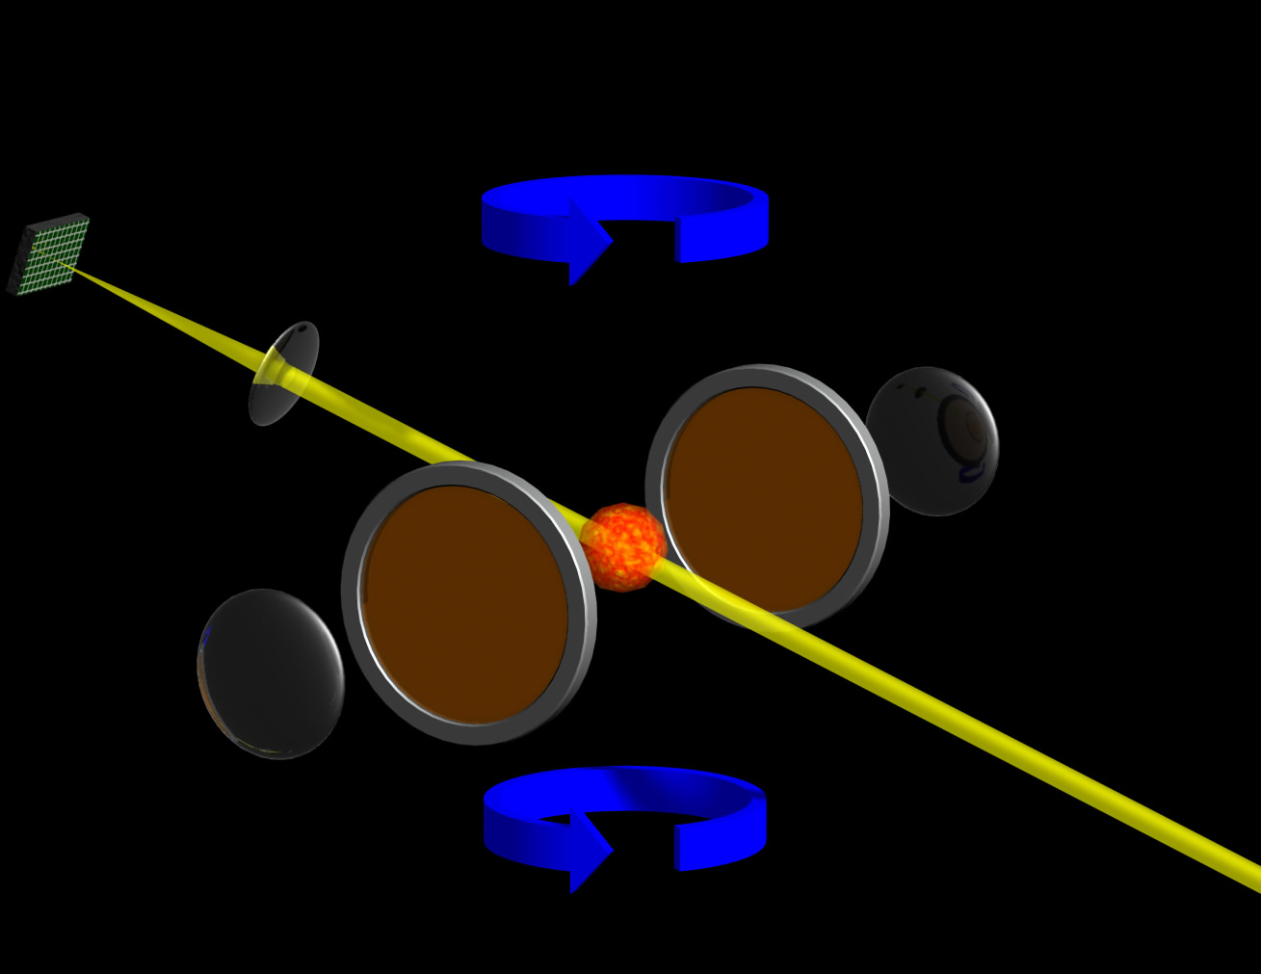
Experimental Method
Optical Trap Loading
Forced Evaporation
Imaging
Notes:
-The starting point for our experiments is a balanced mixture of Li-6 atoms, evaporatively cooled in an optical dipole trap
-We use a crossed beam dipole trap with two independently controlled trapping lasers which allows us to vary the harmonic confinement frequencies over a wide range
-After evaporation, we typically end up with … atoms in each spin state at a temperature of … at unitarity
-From here we can ramp the magnetic field to access different interactions via the broad FR at 834 G.

Slide 10






Ultracold Fermi Gases
We cool a 50/50 mixture of ⁶Li atoms in an optical trap near the 834 G Feshbach resonance
Feshbach Coils
Glass Vacuum Cell
Li atoms
Trap beam 2
Trap beam 1
BEC
Unitary
BCS
650 G
834 G
991 G
Notes:
-The starting point for our experiments is a balanced mixture of Li-6 atoms, evaporatively cooled in an optical dipole trap
-We use a crossed beam dipole trap with two independently controlled trapping lasers which allows us to vary the harmonic confinement frequencies over a wide range
-After evaporation, we typically end up with … atoms in each spin state at a temperature of … at unitarity
-From here we can ramp the magnetic field to access different interactions via the broad FR at 834 G.

Slide 11
Ultracold Fermi Gases
We can prepare degenerate Fermi gases or BECs of molecules depending on the magnetic field
BEC
Unitary
BCS
B = 650 G
B = 834 G
B = 991 G

Slide 12
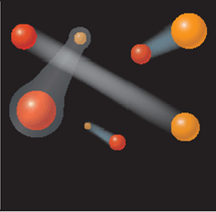
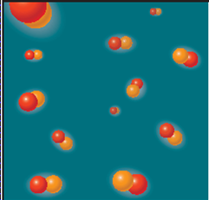
Feshbach Resonance
Notes:
-The starting point for our experiments is a balanced mixture of Li-6 atoms, evaporatively cooled in an optical dipole trap
-We use a crossed beam dipole trap with two independently controlled trapping lasers which allows us to vary the harmonic confinement frequencies over a wide range
-After evaporation, we typically end up with … atoms in each spin state at a temperature of … at unitarity
-From here we can ramp the magnetic field to access different interactions via the broad FR at 834 G.

Slide 13
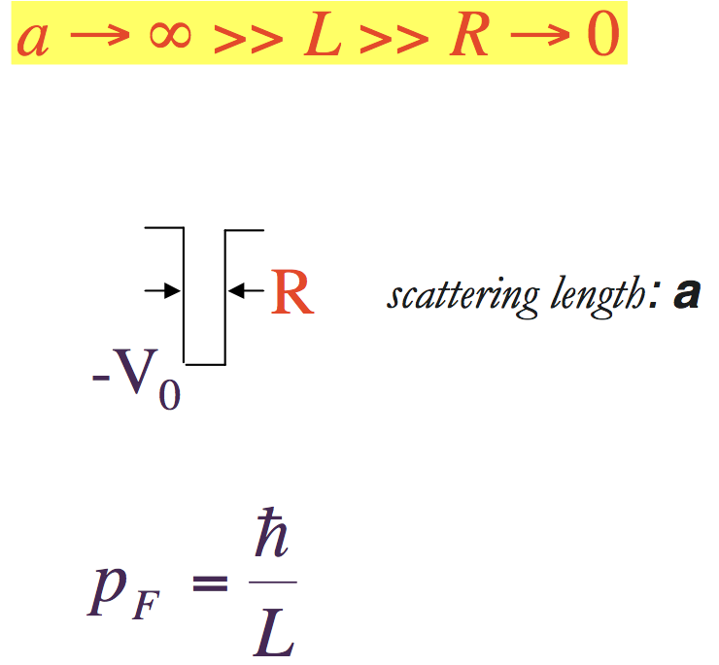
Unitarity Limit
L
Notes:
-The starting point for our experiments is a balanced mixture of Li-6 atoms, evaporatively cooled in an optical dipole trap
-We use a crossed beam dipole trap with two independently controlled trapping lasers which allows us to vary the harmonic confinement frequencies over a wide range
-After evaporation, we typically end up with … atoms in each spin state at a temperature of … at unitarity
-From here we can ramp the magnetic field to access different interactions via the broad FR at 834 G.

Slide 14
Cross-sections saturate!
For strong interactions, the
scattering length a is infinite.
The scattering cross-section
reaches a finite limit, called the unitarity limit.
The value of a is irrelevant.
Only the spacing L remains!
L
Notes:
-The starting point for our experiments is a balanced mixture of Li-6 atoms, evaporatively cooled in an optical dipole trap
-We use a crossed beam dipole trap with two independently controlled trapping lasers which allows us to vary the harmonic confinement frequencies over a wide range
-After evaporation, we typically end up with … atoms in each spin state at a temperature of … at unitarity
-From here we can ramp the magnetic field to access different interactions via the broad FR at 834 G.

Slide 15
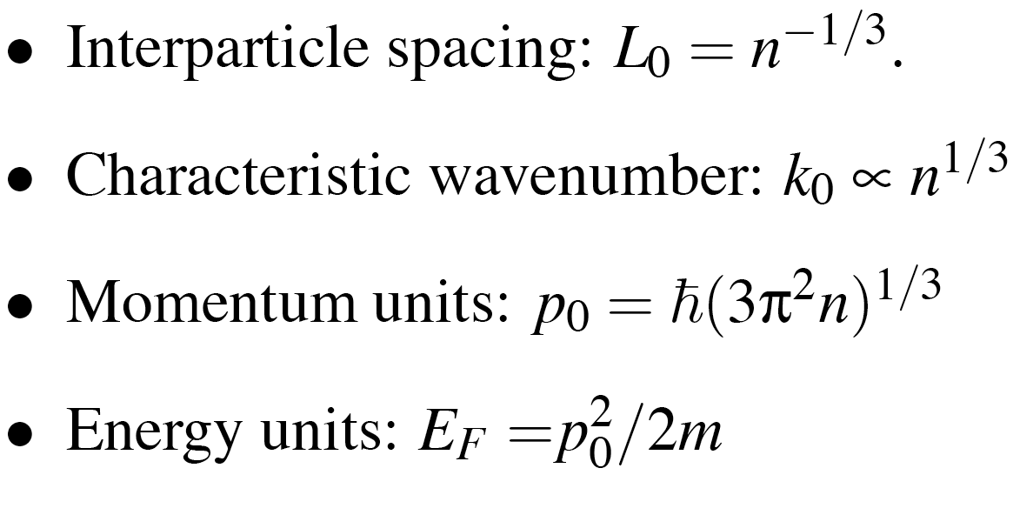
Universality Conjecture: One length scale: L = n^{-1/3} Thermodynamics independent of structure
Notes:
-The starting point for our experiments is a balanced mixture of Li-6 atoms, evaporatively cooled in an optical dipole trap
-We use a crossed beam dipole trap with two independently controlled trapping lasers which allows us to vary the harmonic confinement frequencies over a wide range
-After evaporation, we typically end up with … atoms in each spin state at a temperature of … at unitarity
-From here we can ramp the magnetic field to access different interactions via the broad FR at 834 G.

Slide 16
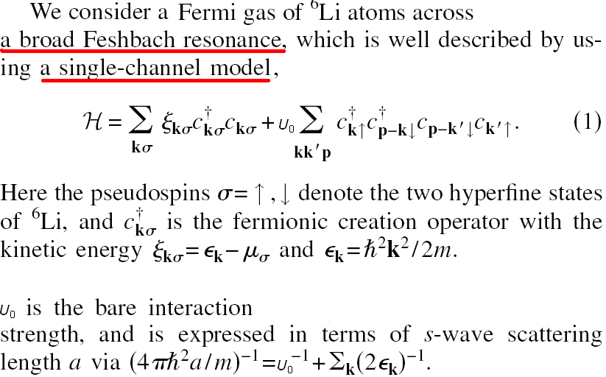
Single-Channel Theory
Notes:
-The starting point for our experiments is a balanced mixture of Li-6 atoms, evaporatively cooled in an optical dipole trap
-We use a crossed beam dipole trap with two independently controlled trapping lasers which allows us to vary the harmonic confinement frequencies over a wide range
-After evaporation, we typically end up with … atoms in each spin state at a temperature of … at unitarity
-From here we can ramp the magnetic field to access different interactions via the broad FR at 834 G.

Slide 17
Low temperature T-matrix Theories

Slide 18
Three Possibilities
GG – self-consistent theory
G₀G₀ – non self-consistent theory
NSR – Gaussian pair-fluctuation theory

Slide 19
Unitarity Ground State
H. Hu, X.-J. Liu and P. D. D, Europhys. Lett. 74, 574 (2006).
Notes:
-The starting point for our experiments is a balanced mixture of Li-6 atoms, evaporatively cooled in an optical dipole trap
-We use a crossed beam dipole trap with two independently controlled trapping lasers which allows us to vary the harmonic confinement frequencies over a wide range
-After evaporation, we typically end up with … atoms in each spin state at a temperature of … at unitarity
-From here we can ramp the magnetic field to access different interactions via the broad FR at 834 G.

Slide 20
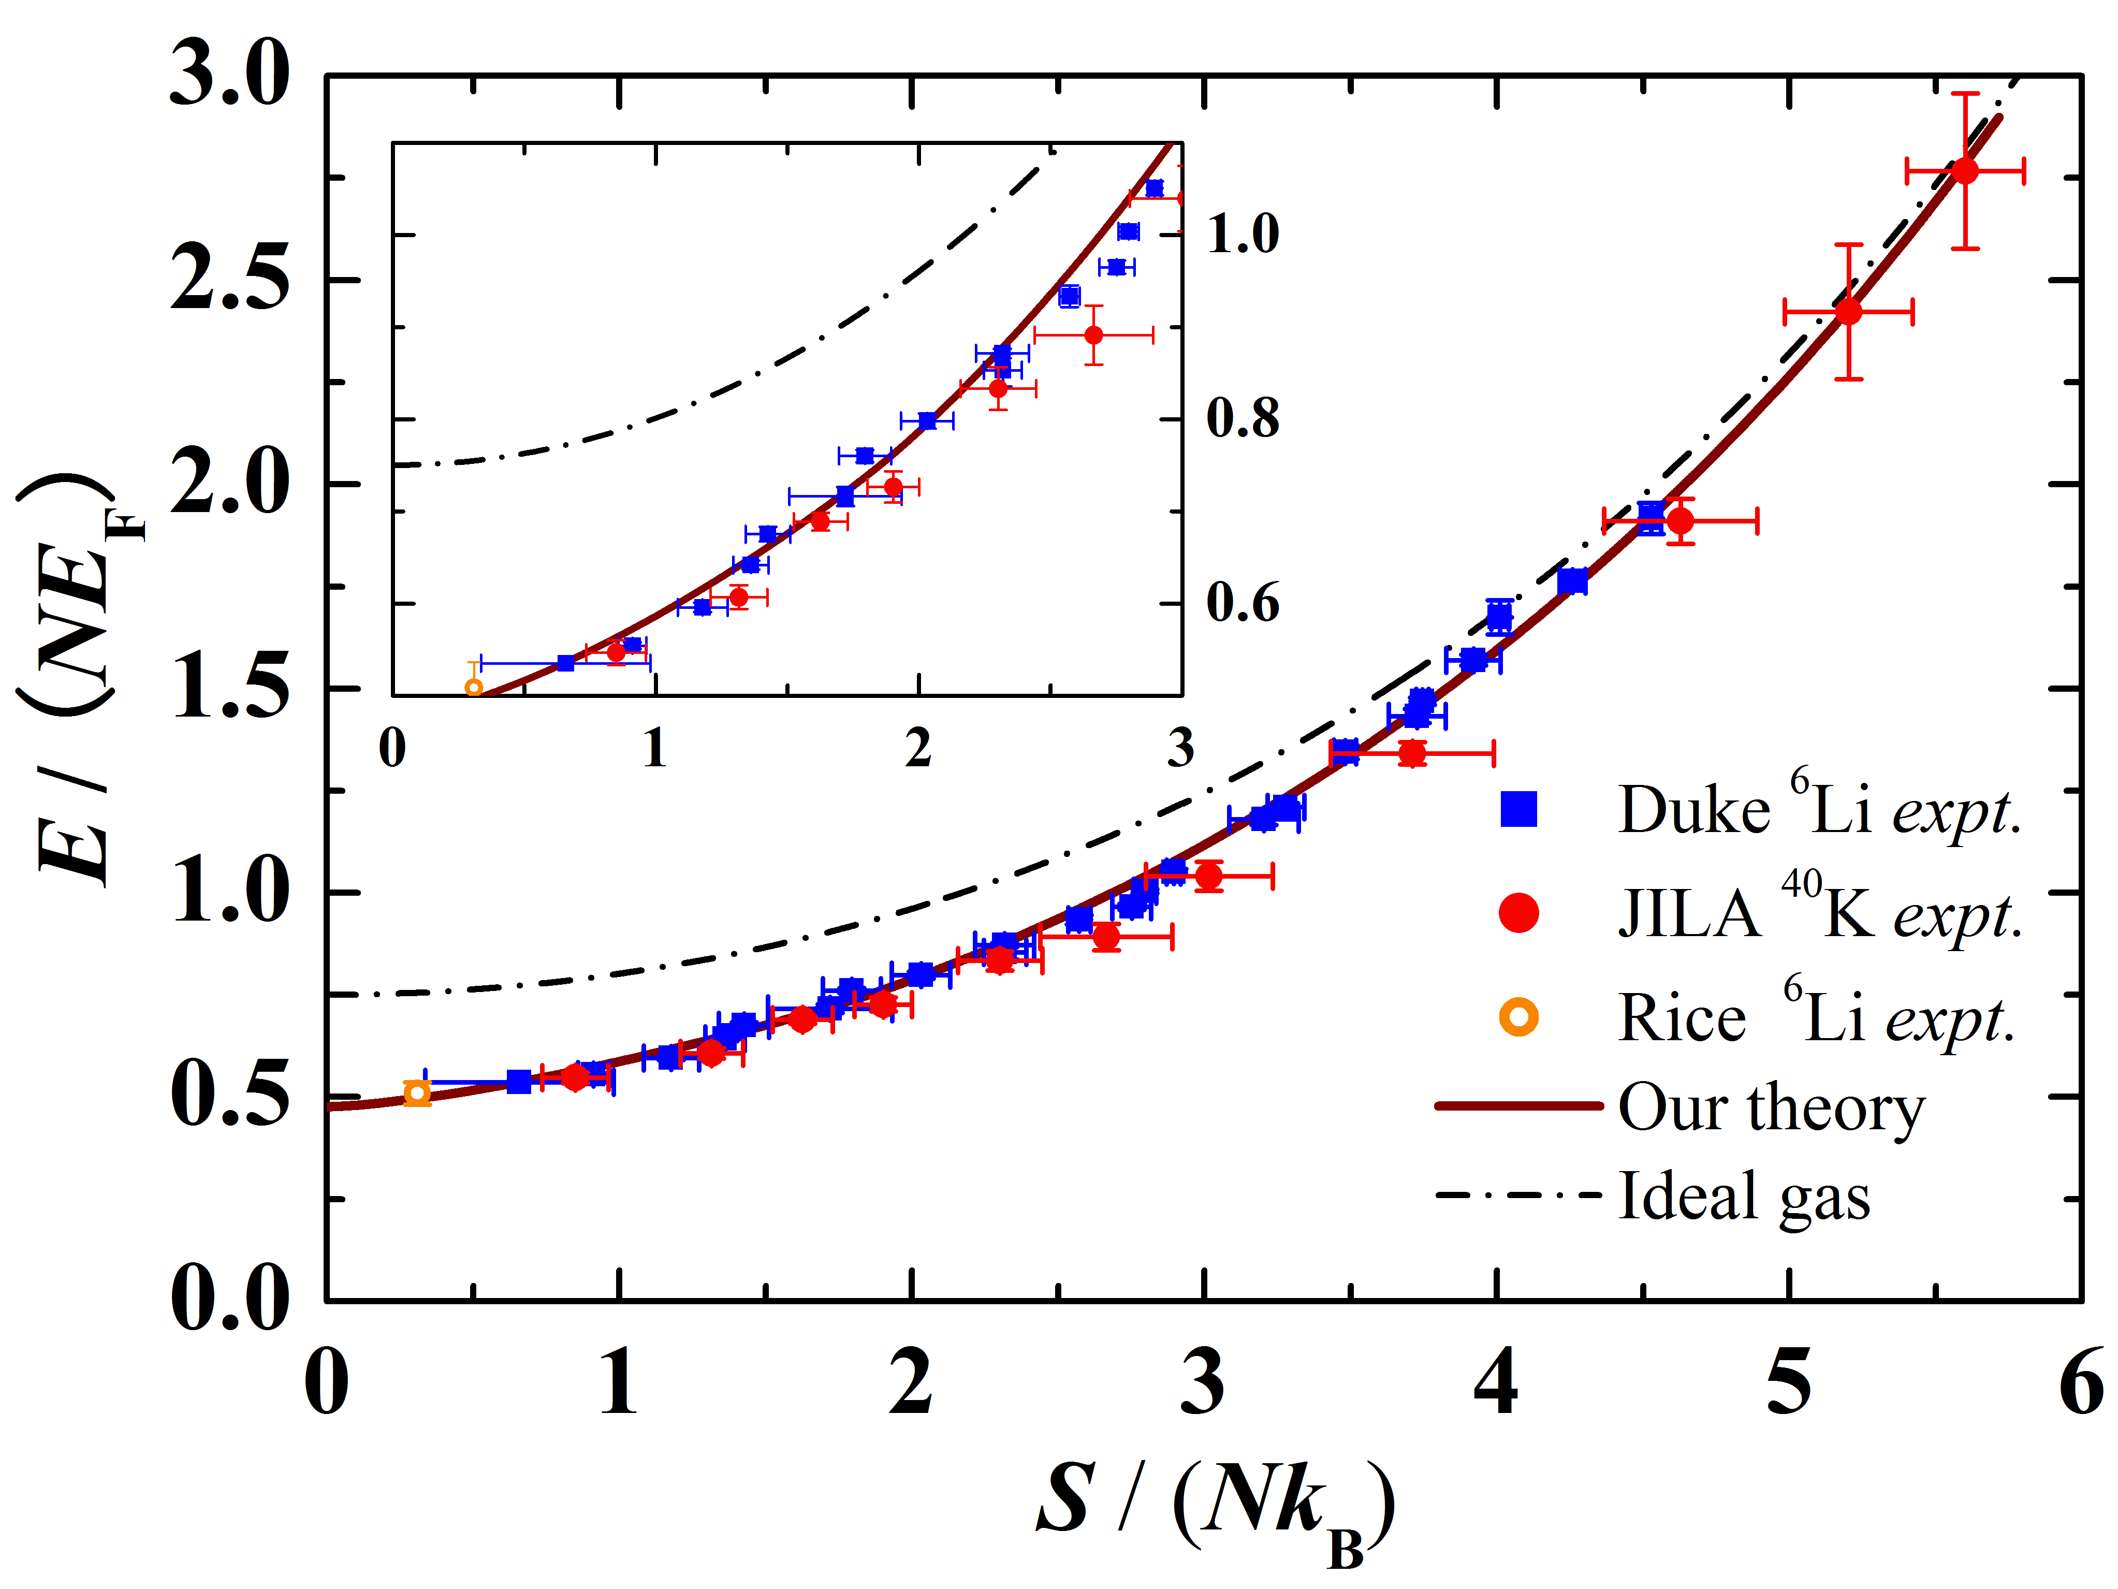
Evidence For Universality
Hui Hu, Peter D. Drummond, Xia-Ji Liu,, Nature Physics 3, 469 - 472 (2007)
Notes:
-The starting point for our experiments is a balanced mixture of Li-6 atoms, evaporatively cooled in an optical dipole trap
-We use a crossed beam dipole trap with two independently controlled trapping lasers which allows us to vary the harmonic confinement frequencies over a wide range
-After evaporation, we typically end up with … atoms in each spin state at a temperature of … at unitarity
-From here we can ramp the magnetic field to access different interactions via the broad FR at 834 G.

Slide 21

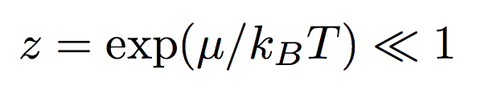
Virial Expansion Method
Calculate coefficients from trapped bound states
Homogeneous coefficients from trapped results
Liu et al., PRL 102, 160401 (2009)

Slide 22
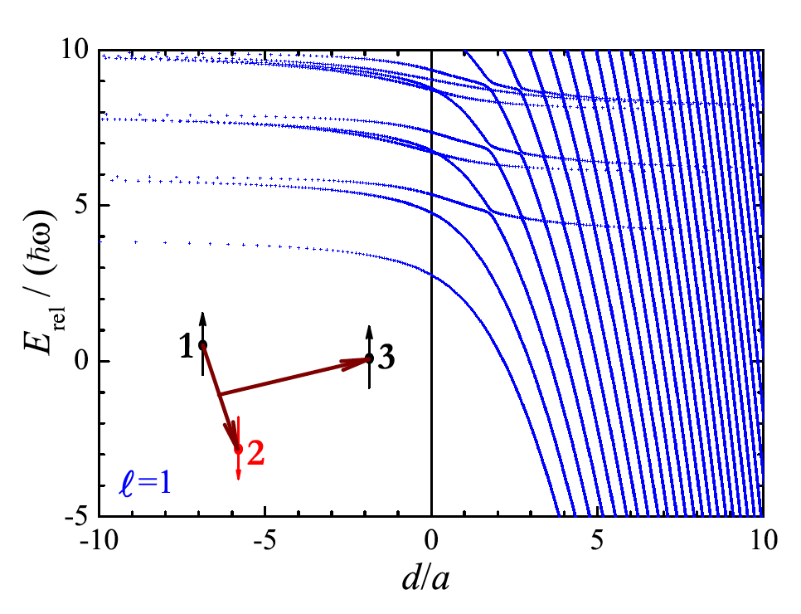
Three-body energy
Notes:
-The starting point for our experiments is a balanced mixture of Li-6 atoms, evaporatively cooled in an optical dipole trap
-We use a crossed beam dipole trap with two independently controlled trapping lasers which allows us to vary the harmonic confinement frequencies over a wide range
-After evaporation, we typically end up with … atoms in each spin state at a temperature of … at unitarity
-From here we can ramp the magnetic field to access different interactions via the broad FR at 834 G.

Slide 23

Predicted b₃ at unitarity
Previous field theory result: +1.11
Experiment - ENS, 2011: -0.29(2)
Notes:
-The starting point for our experiments is a balanced mixture of Li-6 atoms, evaporatively cooled in an optical dipole trap
-We use a crossed beam dipole trap with two independently controlled trapping lasers which allows us to vary the harmonic confinement frequencies over a wide range
-After evaporation, we typically end up with … atoms in each spin state at a temperature of … at unitarity
-From here we can ramp the magnetic field to access different interactions via the broad FR at 834 G.

Slide 24
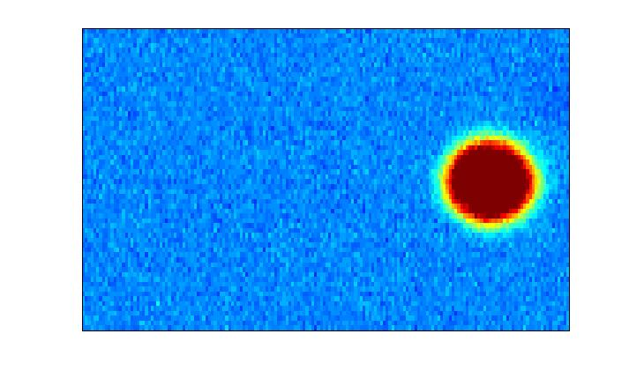
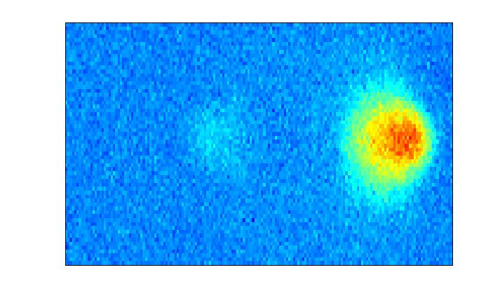



Bragg Scattering
Illuminate a cloud with a “moving” standing wave
Can scatter molecules (pairs) / atoms by selecting ω
Atom cloud
Unscattered
ν + ω
ν
Bragg condition
Bragg scattered
Notes:
- Bragg scattering is achieved by …

Slide 25
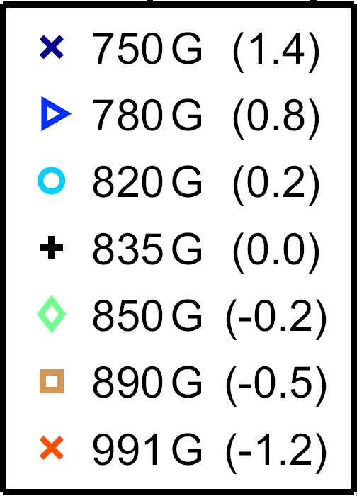
Bragg Spectroscopy
Previously measured spectra in the BEC-BCS crossover
BEC
ΔX_{COM} (μm)
BCS
ω/2π (kHz)
Veeravalli et al., PRL 101, 250403 (2008)

Slide 26
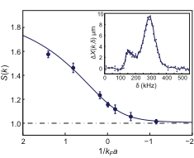

Static Structure Factor
This greatly improves the measurement accuracy of S(k) through the BEC-BCS crossover
S(k) decays from 2 – 1 through the BEC-BCS crossover due to the decay of g↑↓⁽²⁾(r), in good agreement with theory
Kuhnle et al., Phys. Rev. Lett. 105, 070402 (2010)., Hu et al., Europhysics Letters 91, 20005 (2010).

Slide 27


Tan’s Universal Relations
In 2005 Shina Tan derived several exact relations linking macroscopic properties to a single microscopic parameter, the contact –
Tan, Ann Phys 323, 2952; 2971; 2987 (2008).
Two examples of Tan relations are:
now verified experimentally
Stewart et al., PRL 104, 235301 (2010)
These apply to: - Superfluid / normal phases (0 or finite T)
- Few-body / many-body systems
Punk and Zwerger, PRL 99, 170404 (2007)
Braaten and Platter, PRL 100, 205301 (2008)
Zhang and Leggett, PRA 79, 023601 (2009)
Partridge et al., PRL 95, 020404 (2005)
Werner, Tarruell and Castin, EPJ B 68, 401 (2009)
Notes:
In 2005 Shina Tan made some dramatic progress by deriving several exact relations to describe these Fermi systems in the BEC-BCS crossover,
Tan used the result that the range of the interaction potential r_0 is always small and from this was able to show a number of relations linking bulk properties of the system to microscopic parameter, known as the contact.
Tan’s results have broad applicability across the BEC-BCS crossover, they apply to SF/normal, Few/many
There have been a number of related studies both theoretical and expt., in particular the first measurements of the contact and the verification of 2 of Tan’s universal laws.

Slide 28
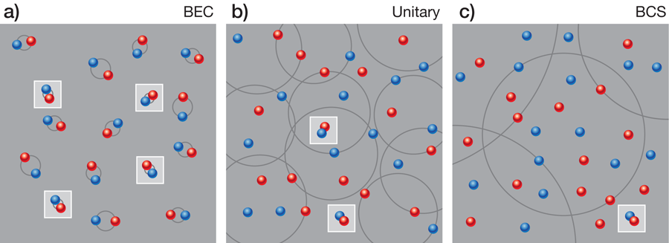



Tan’s Universal Relations
Contact is defined as:
BEC
Unitary
BCS
Braaten, Physics 2, 9 (2009)
quantifies the number of closely spaced pairs!
depends upon :- and
Notes:
As mentioned earlier, Tan’s relations invoke a microscopic quantity known as the contact
Contact measures the probability of finding two spin up/spin down Fermions close enough to eachother to interact, as U® is short range, even though a is large, the particles must be very close to experience a shift in their energy
The idea of contact is shown in this figure …
Contact depends on – the relative temperature and the dimensionless interaction strength.

Slide 29



Universal Pairing
Here, we examine Tan’s universal pairing relation
Tan showed that the spin-up / spin-down density-density correlation function is given by
Correlation functions are generally hard to measure
- BUT, we can consider the Fourier transform
Notes:
Here, we are focussing on a new exact relation which arises directly from Tan’s laws
Tan showed that the up/down pair correlation function is given by this which is directly proportional to the contact
While correlation functions are difficult to measure directly in ultracold gases, we can also consider related quantities such as the static structure factor

Slide 30

Universal Pairing
The Fourier transform of this expression gives a new universal relation for the static structure factor
S↑↓(k) has a simple analytic dependence on (k/k_{F})
S(k) can be measured experimentally using inelastic Bragg spectroscopy
Stamper-Kurn et al., PRL 83, 2876 (1999)
Steinhauer et al., PRL 88, 120407 (2002)
Combescot et al. EPL 75, 695 (2006)
Veeravalli et al., PRL 101, 250403 (2008)
Notes:
The Fourier transform of Tan’s pairing relation gives the following for S_up/down (k)
This has a simple analytic dependence on the relative probe momentum, and the dimensionless interaction strength
The total structure factor can be measured experimentally using Bragg spectroscopy
In an unpolarised strongly interacting Fermi gas this consists of two contributions, one due to correlations between particles in the same state, and the other due to up/down correlations.
For the range of momenta we consider, Sup up is essentially one as we are scattering to unoccupied states so Supup approaches its uncorrelated value of one

Slide 31
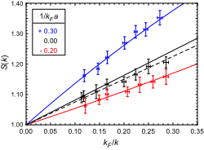
Universal S(k)
We vary k/k_{F} over the range 3.5 – 9.1 and also vary B to achieve the desired value of 1/(k_{F}a) for each point
Kuhnle et al., Phys. Rev. Lett. 105, 070402 (2010).

Slide 32
Contact Virial Expansion
Calculate coefficients from trapped bound states
Homogeneous coefficients from trapped results
Liu et al., PRL 102, 160401 (2009);
H. Hu, et al. Phys Rev A 81, 033630 (2010).

Slide 33
Summary of Experiments

Slide 34
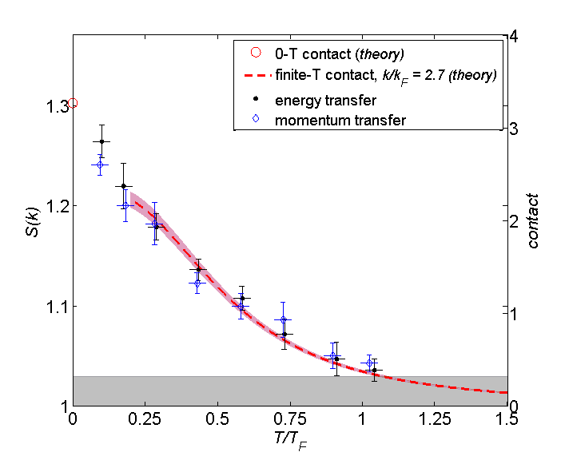
Finite Temperatures
Both methods of measuring S(k) give similar values
Theory - virial expansion
Liu et al., PRL 102, 160401 (2009)
Preformed pairs exist far above T_{c}

Slide 35
Homogeneous case

Slide 36
Trapped case

Slide 37
Conclusions and Outlook
Universal Fermi behaviour is accurately verified
Contact (pair-correlations) at unitarity are seen to persist at temperatures well above T_{c}
Virial theory converges well above T_{c}
Strong coupling theories give different predictions
Contact measurements provide a new fingerprint
Conjecture: contact decreases with temperature

